Slide 1
Notes:
Alternative start to presentations with logo alone.

Slide 2
I Cry Aloud to God: A Service of Lament and Hope in the Face of the Climate Crisis
The Office of Economic and Environmental Justice and the Office of Spiritual Formation
Notes:
START RECORDING. 3:03

Slide 3
Invocation & Welcome
Notes:
Image: https://www.flickr.com/photos/cogdog/31551563736

Slide 4
Opening Prayer
Notes:
Image: https://www.flickr.com/photos/cogdog/31551563736

Slide 5
Land and Indigenous People’s Recognition To find information on the Indigenous people from your area, go to
Native-land.ca

Slide 6
Spiritual Grounding
The word selah is used throughout Psalm 77. It is a Hebrew word indicating a pause; we are to stop and listen.

Slide 7
“Daughters of Zion/Wake Up, Jesus”
Latifah Alattas
Notes:
Insert Video Clip Here: Cindy Saufferer

Slide 8
Psalm 77
I cry aloud to God, aloud to God, that [God] may hear me. In the day of my trouble I seek the Lord; in the night my hand is stretched out without wearying; my soul refuses to be comforted. I think of God, and I moan; I meditate, and my spirit faints. Selah

Slide 9
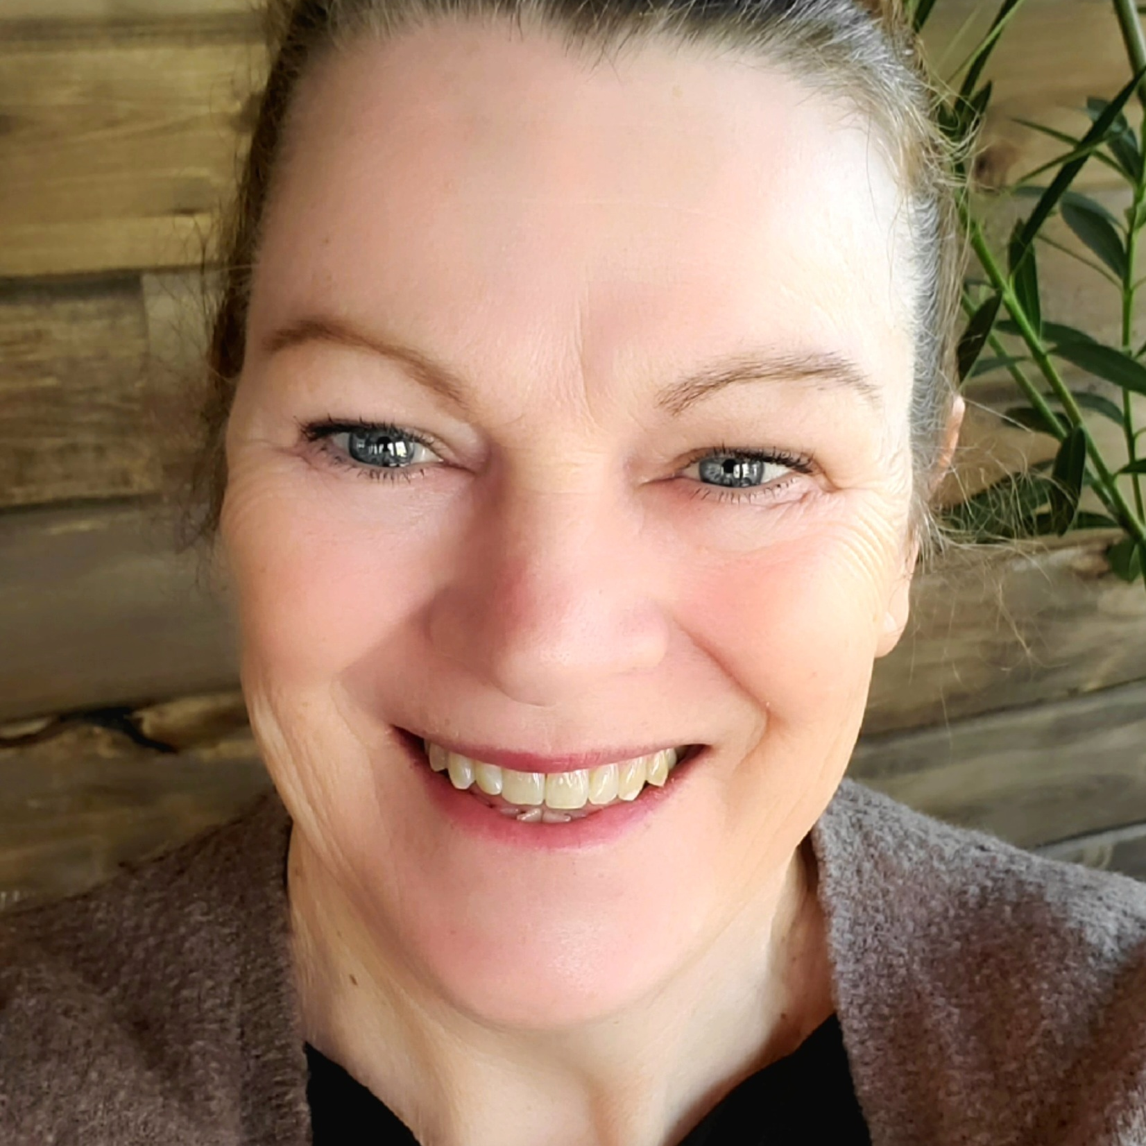
Cindy Saufferer
United Women in Faith
Minnesota Conference President

Slide 10
Notes:
Insert Video Clip Here: Cindy Saufferer

Slide 11
Selah
Take a moment to write down or sketch what resonates with you.

Slide 12
What are you lamenting?
Follow the link in the chat to add your response to our word cloud.
Notes:
Embed Word Cloud here. Question: What are you lamenting?
Alternatively, stop sharing PPT and switch to sharing Word Cloud results.

Slide 13
Psalm 77
You keep my eyelids from closing; I am so troubled that I cannot speak. I consider the days of old, and remember the years of long ago. I commune with my heart in the night; I meditate and search my spirit: “Will the Lord spurn forever, and never again be favorable?

Slide 14
Psalm 77
Has his steadfast love ceased forever?​ Are his promises at an end for all time?​ Has God forgotten to be gracious?​ Has he in anger shut up his compassion?” Selah​ And I say, “It is my grief​ that the right hand of the Most High has changed.”

Slide 15
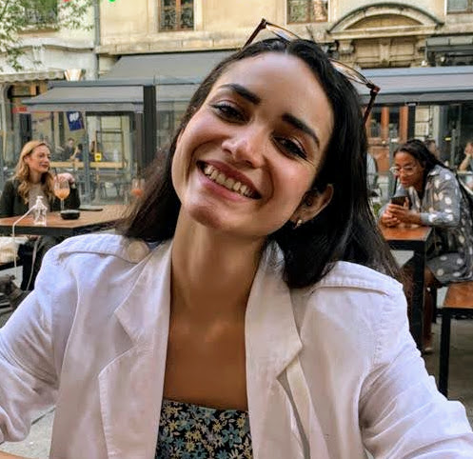
Ilka Vega
Executive for Economic and Environmental Justice
United Women in Faith

Slide 16
Notes:
Insert video clip here

Slide 17
Selah
Take a moment to write down or sketch what resonates with you.

Slide 18
Prayers of the People From “Weathering The Storm,” Earth Day 2022 Liturgy, Creation Justice Ministries

Slide 19
Leader: For all those around the world who have lost their homes, livelihoods, or communities to the climate crisis.
Congregation: Lord, hear our prayer.
Leader: For our nonhuman siblings whose habitats are destroyed by the effects of greed and accumulation.
Congregation: Lord, hear our prayer.

Slide 20
Leader: For decision-makers, that their choices might create a more beautiful, whole, resilient world.
Congregation: Lord, hear our prayer.
Leader: For our own church, that we might be bearers of hope and resilience in our community, a place of refuge in the midst of crisis and disaster.
Congregation: Lord, hear our prayer.
All: Amen.

Slide 21
Psalm 77
I will call to mind the deeds of the Lord; I will remember your wonders of old. I will meditate on all your work, and muse on your mighty deeds. Your way, O God, is holy. What god is so great as our God? You are the God who works wonders; you have displayed your might among the peoples. With your strong arm you redeemed your people, the descendants of Jacob and Joseph. Selah

Slide 22
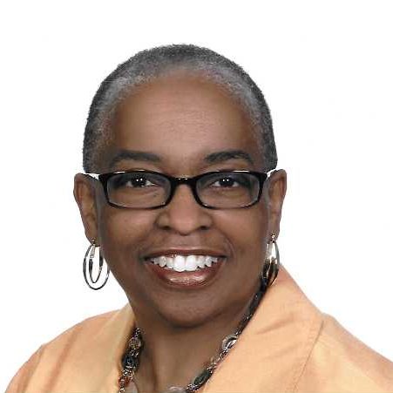
Cynthia Taylor
Creation Care Team Member
Baltimore-Washington Conference

Slide 23
Notes:
Insert Video Clip Here

Slide 24
Selah
Take a moment to write down or sketch what resonates with you.

Slide 25
Breakout Sessions: Remembering
Share about when you have felt the Spirit of God in the movement for justice.
How is the Spirit calling you now to move forward in the work for climate justice?

Slide 26
Psalm 77
When the waters saw you, O God, when the waters saw you, they were afraid; the very deep trembled. The clouds poured out water; the skies thundered; your arrows flashed on every side. The crash of your thunder was in the whirlwind; your lightnings lit up the world; the earth trembled and shook.

Slide 27
Psalm 77
Your way was through the sea, your path, through the mighty waters; yet your footprints were unseen. You led your people like a flock by the hand of Moses and Aaron.

Slide 28
Elizabeth Chun Hye LEE
Director of Mobilization and Advocacy
United Women in Faith

Slide 29
Notes:
Add video clip here

Slide 30
Selah
Take a moment to write down or sketch what resonates with you.

Slide 31
Breakout Sessions: Practice
What resonates with you in practicing lament, questioning, remembering, and hope?

Slide 32
“Such actions refuse despair, because they constitute an act of both remembering and hoping. At the same time these disciplines refuse denial because they look circumstance full in the face. For every praise there is a lament. For every thanks there is voiced need. For every act of neighbor, there is a sense of the legitimacy of self. By such resolved practices faithful people are not overwhelmed by circumstance. They rather redefine circumstance as a venue for a chance to live differently by fidelity that yields energy, courage, and even joy.”
—Walter Brueggemann, Church Anew column

Slide 33
Raise one hand to the screen and say:
As children of God, we refuse despair.

Slide 34
Raise one hand to the screen and say:
As children of God, we refuse despair.
There is hope in the resurrection;

Slide 35
Raise one hand to the screen and say:
As children of God, we refuse despair.
There is hope in the resurrection;
There is strength in our community;

Slide 36
Raise one hand to the screen and say:
As children of God, we refuse despair.
There is hope in the resurrection;
There is strength in our community;
There is faith in the unknown.

Slide 37
Raise your other hand and say:
As followers of Jesus, we refuse denial.

Slide 38
Raise your other hand and say:
As followers of Jesus, we refuse denial.
We see the state of climate change;

Slide 39
Raise your other hand and say:
As followers of Jesus, we refuse denial.
We see the state of climate change;
We acknowledge the destruction that has been
going on for too long.

Slide 40
Raise your other hand and say:
As followers of Jesus, we refuse denial.
We see the state of climate change;
We acknowledge the destruction that has been
going on for too long.
And our work is important.

Slide 41
What is your vision for climate justice?
Follow the link in the chat to add your response to our word cloud.
Notes:
Embed Word Cloud here. Question: What is your vision for climate justice?
Alternatively, stop sharing PPT and switch to sharing Word Cloud results.

Slide 42
“Your Labor Is Not in Vain”
Latifah Alattas
Notes:
Insert Video Clip Here: Cindy Saufferer

